Slide 1

CCDPH Public Health Data Sharing Ecosystem

Slide 2


CCDPH PUBLIC HEALTH DATA SHARING ECOSYSTEM
The atlas is an important component of CCDPH’s broader, multi-platform public health awareness, data and code sharing ecosystem.
CCDPH STORYMAPS, DASHBOARDS AND REPORTS
SCC HEALTH ATLAS
Comprehensive, online health indicator data exploration and visualization tools designed for the broadest range of users
Immersive, topic-specific public health information presented using a combination of multimedia content including text and interactive maps
CCDPH GITHUB REPOSITORIES
CCDPH DATA REQUESTS
Delimited datasets, geographic feature layers and associated programming code made available for expert users
Online forms for partner agencies, researchers, community groups and the general public to request custom CCDPH datasets.
Notes:
The Cook County Department of Pub lic Health’s Epidemiology Unit is leading an effort to design and deploy an online health atlas for suburban Cook County. We envision the atlas to be a platform for sharing a wealth of information to improve public health awareness and individual, agency decision-making.

Slide 3

HEALTH ATLAS INDICATOR CATEGORIES
Indicators on the health atlas are organized into six primary categories.
HEALTH OUTCOMES
DEMOGRAPHICS
Consequences, complications and other outcomes that result from disease (e.g., injury, hospitalization, death).
Population characteristics including community size, composition and structure (e.g., population, age, gender, race/ethnicity, migration).
The platform integrates several types of data
HEALTH BEHAVIORS
SOCIOECONOMIC
Individual activities that influence health (e.g., alcohol, drug and tobacco use; diet, physical activity, sleep).
Social and economic factors that can affect health (e.g., income, employment, education, segregation).
HEALTH CARE
PHYSICAL ENVIRONMENT
Systems and services for administering care (e.g., health screenings; primary, prenatal and dental care; clinics, hospitals, FQHCs).
Characteristics of the places where individuals where individuals live, learn, work, and play (e.g., parks, housing, air quality, water quality and transportation)
Notes:
In addition, the atlas contains several quality of life and risk indices related to public health that combine indicators across the six categories (e.g., social vulnerability index, index of concentration of extremes, neighborhood deprivation).

Slide 4
HEALTH ATLAS INDICATOR SUB-CATEGORIES
The six primary categories are further broken down into several subcategories.
HEALTH OUTCOMES
PHYSICAL ENVIRONMENT
HEALTH BEHAVIORS
SOCIOECONOMIC
Chronic disease
Communicable disease
Injury & violence
Maternal & child
Dental
Community safety
Housing
Transportation
Pollution exposure
Environmental risk
Food access
Alcohol & drug use
Tobacco & e-cigar.
Diet & exercise
Sexual activity
Community
HEALTH CARE
DEMOGRAPHICS
Income
Education
Employment
Public assistance
Population age
Sex & gender
Race & ethnicity
Household structure
Language
Migration status
Access to care
Quality of care
Facility utilization
Vaccines/screenings

Slide 5
health atlas FIRST YEAR DATA RELEASE TIMELINE
The atlas will be continually updated with the latest public health information for suburban Cook County. The rollout of the data over the first year will proceed in four phases. With each phase, the Epi Unit will reach out to other CCDPH units, the county and community-based contacts for data requests and feedback.
01
02
03
04
PHASE ONE (May 2022)
PHASE TWO
(July 2022)
PHASE THREE
(September 2022)
PHASE FOUR
(April 2023)
Select indicators from CCDPH’s latest Community Health Status Assessment; Social Vulnerability; Communicable disease prevalence; Opioid deaths
2013 to 2020 birth and death rates; 2020 Youth Risk Behavioral Survey data; Environmental justice screening data
2018 to 2020 hospitalization inpatient and outpatient data
2022 Suburban Cook County Health Survey data; 2022 Youth Risk Behavioral Survey data

Slide 6
Indicator update workflow
CCDPH staff update data with respect to a workflow.
01
02
03
04
PHASE ONE (May 2022)
PHASE TWO
(July 2022)
PHASE THREE
(September 2022)
PHASE FOUR
(April 2023)
Select indicators from CCDPH’s latest Community Health Status Assessment; Social Vulnerability; Communicable disease prevalence; Opioid deaths
2013 to 2020 birth and death rates; 2020 Youth Risk Behavioral Survey data; Environmental justice screening data
2018 to 2020 hospitalization inpatient and outpatient data
2022 Suburban Cook County Health Survey data; 2022 Youth Risk Behavioral Survey data

Slide 7
1
CREATE A CAREER PLAN
2
NETWORK
Use your skills as a project manager to plan goals and develop a schedule with steps that get you there.
Involve yourself with trade groups and other organizations where like-minded professionals meet.
5
BE A GREAT
COMMUNICATOR
4
WEAR MANY HATS
3
BE A THOUGHT
LEADER
Communication is key to everything, but it’s as important to listen as it is to speak.
Project managers are involved in every aspect of a project. Move smoothly through these disciplines, you’ll be highly sought after.
Use your skills and experience to help others and get noticed.

Slide 8
Indicator DEVELOPMENT/MAINTENANCE workflow
CCDPH staff will develop and maintain atlas indicators according to a standard workflow.
SOURCE DATA TO ATLAS INDICATOR WORKFLOW
ACQUIRE SOURCE DATA
SUMMARIZE DATA
INDICATOR DEVELOPMENT
UPLOAD TO ATLAS
Work with data source providers to establish DUA; Collect/submit signatures for data users; Acquire data dictionary from data source; develop/revise import code; import data into atlas RDB table.
Develop/revise summary data code stored on atlas GitHub;
IMPORT INTO
DATABASE
DUA
DOWNLOAD
RAW DATA
Notes:
Acquire and store raw source data
Acquired data may be of three types:
primary (e.g., health or other survey data collection efforts administered internally by CCDPH);
secondary (e.g., vital statistics, hospitalization records, reportable disease cases/deaths, syndromic, medical examiner, census and other case and/or aggregated information made available from external data provider) ;
tertiary (e.g., SVI, childhood opportunity, EJ screening, pollution monitoring data and other pre-calculated metrics from external data provider)
When applicable, store raw data as tables within relational database using standard naming convention (e.g., name_source_raw_yyyymmdd). Collected data may or may not include protected health information (PHI). In some cases, it may be necessary for staff to work with data providers to establish a data use agreement (DUA), collect/submit signatures for data users. All data should include a data dictionary with essential metadata including dataset summary, column names and descriptions, data sources, data year, date information was received/accessed, data contact, etc.

Slide 9
ATLAS Indicator DEVELOPMENT/MAINTENANCE workflow
CCDPH staff will develop and maintain atlas indicators according to a standard workflow.
SOURCE DATA TO ATLAS INDICATOR WORKFLOW
ACQUIRE SOURCE DATA
DATA PROCESSING
INDICATOR DEVELOPMENT
UPLOAD TO ATLAS
Acquire indicator source data of various types using appropriate protocols. Save data documentation, table dictionaries and any import code to SCCHA GitHub repository. Save copy of raw tables to SCCHA database.
Perform cleaning, geocoding and other data quality / control operations. Upload documentation, data dictionaries and processing code to SCCHA GitHub repository. Save copy of processed tables to database.
Aggregate and stratify count data by year and select geographies (e.g., tract, ZCTA, municipality). Calculate rates and format indicators using standard column names. Save code to GitHub and tables in database.
Create indicator placeholder in online atlas. Add indicator metadata. Upload indicators to atlas.
primary
SCCHA GitHub Repo (raw)
SCCHA Databasee (raw)
Clean, geocode and standardize raw data
SCCHA GitHub Repo (form)
SCCHA Databasee (form)
aggregate and stratify count data, calculate rates, format indicators for atlas
SCCHA GitHub Repo (ind)
SCCHA Databasee (ind)
secondary
tertiary
Notes:
Acquire and store raw source data
Acquired data may be of three types:
primary (e.g., health or other survey data collection efforts administered internally by CCDPH);
secondary (e.g., vital statistics, hospitalization records, reportable disease cases/deaths, syndromic, medical examiner, census and other case and/or aggregated information made available from external data provider) ;
tertiary (e.g., SVI, childhood opportunity, EJ screening, pollution monitoring data and other pre-calculated metrics from external data provider)
Collected data may or may not include protected health information (PHI). In some cases, it may be necessary for staff to work with data providers to establish a data use agreement (DUA), collect/submit signatures for data users. All data should include a data dictionary with essential metadata including dataset summary, column names and descriptions, data sources, data year, date information was received/accessed, data contact, etc. Raw data are stored as tables within relational database using a standard naming convention (e.g., name_source_raw_yyyymmdd).

Slide 10
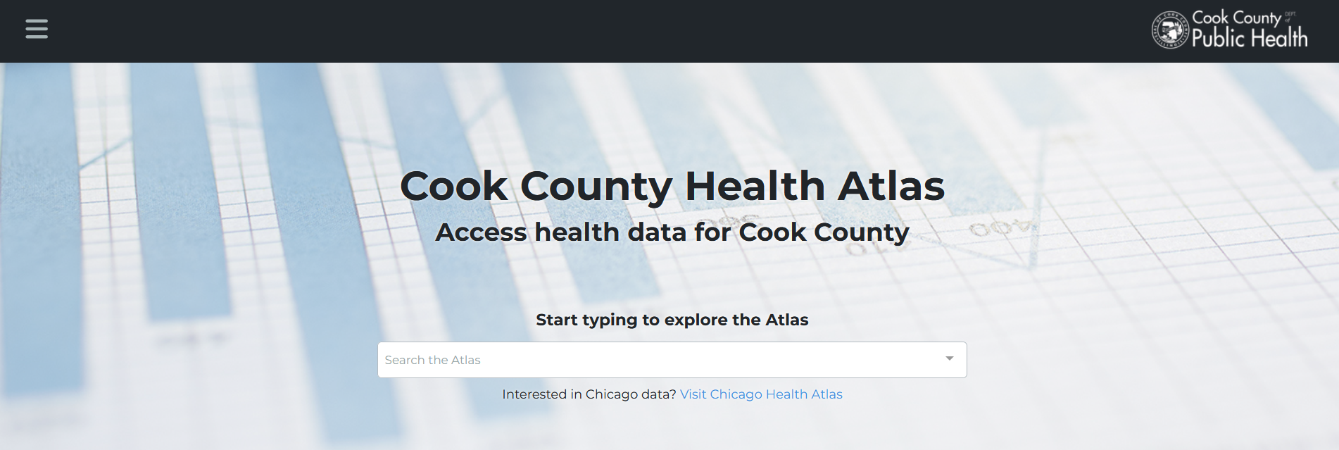
1
2
3
CHOOSE AN ACTIVITY THEME
HEALTH OUTCOMES
DEMOGRAPHICS
SOCIAL DETERMINANTS
Explore community patterns of disease and mortality
Explore neighborhood population characteristics including age, race and ethnicity
Explore indicators of food access and social vulnerability

Slide 11



CO-DESIGNING PUBLIC HEALTH DATA ACCESS & AWARENESS
CCDPH aims to work with VeggieRx to co-design the platform to improve its functionality and usability
(e.g., adding and enriching datasets, tools and documentation)
What did you find interesting with the health atlas?
What did you find confusing about the health atlas?
What types of data or tools could inform VeggieRx programs?
How could CCDPH’s Epi Unit further assist VeggieRx with the atlas?
Notes:
1. interesting?

Slide 12

NEXT STEPS
Identify potential uses &
enhancements
1
Work together to identify ways in which VeggieRx could use and/or improve the health atlas.
2
Implement changes
If needed, upload, edit and/or enhance datasets, tools and documentation on the platform.
3
Formalize use cases
Develop strategies and/or workflows to help VeggieRx utilize enhancements to the health atlas.

Slide 13
INTRA-COUNTY COLLABORATION
CCDPH works with other departments and programs within Cook County to facilitate internal and external
data development and data sharing efforts.

Slide 14
Appendix

Slide 15
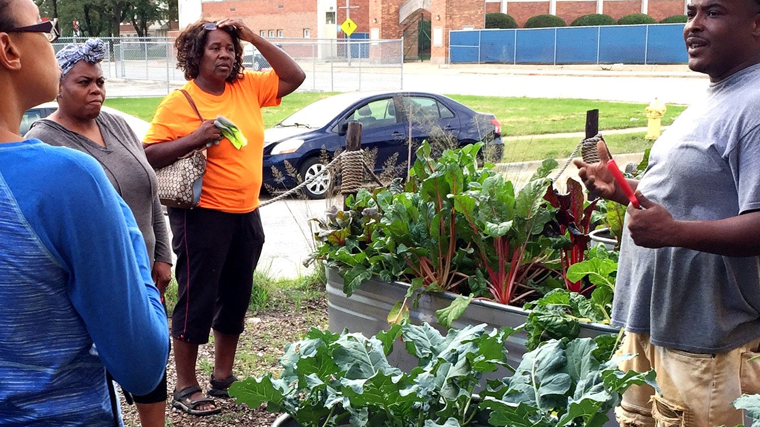
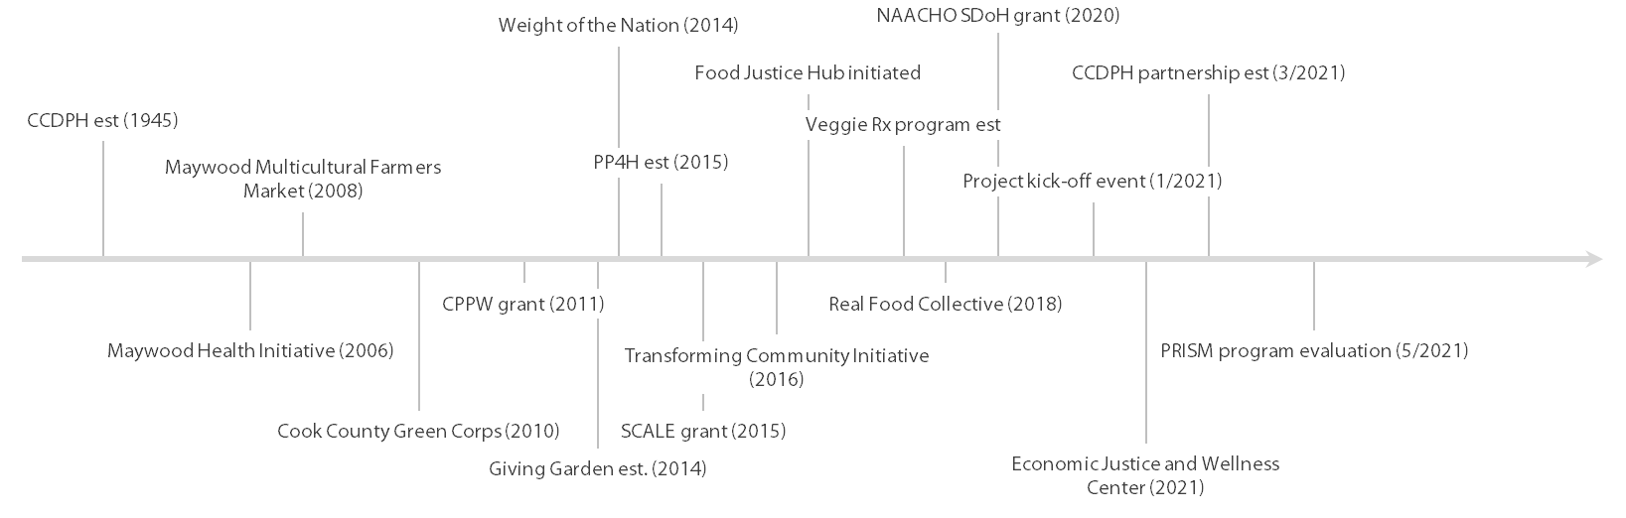
PROJECT BACKGROUND
Leveraging assets on a local scale
Leveraging assets on a national scale
Notes:
Should we update?

Slide 16
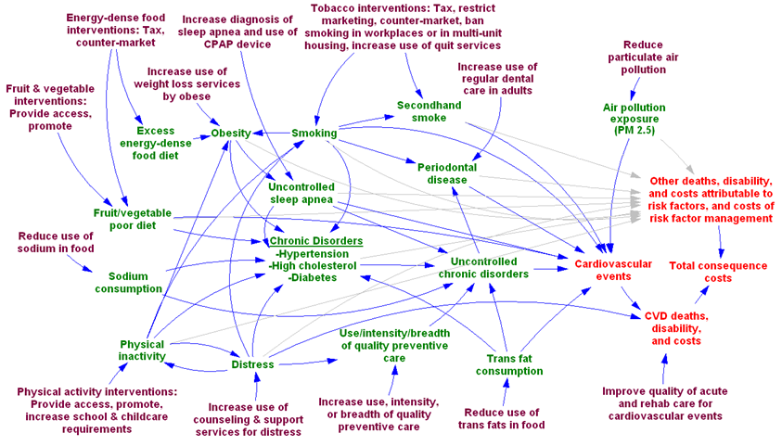
PRISM FRAMEWORK
Source: Adapted from Yarnoff, Benjamin. 2021. “Validation of the Prevention Impacts Simulation Model (PRISM).” Preventing Chronic Disease 18.
Notes:
Mapping the movement between intervention and impact
Touching the lives of individuals
Understanding impact is important
Source: Yarnoff, Benjamin. 2021. “Validation of the Prevention Impacts Simulation Model (PRISM).” Preventing Chronic Disease 18. https://doi.org/10.5888/pcd18.200225.

